Slide 1
Code Golf
The Zen of writing bad code

Slide 2
Code Golf
“Code golf is a type of recreational computer programming competition in which participants strive to achieve the shortest possible source code that solves a certain problem.” -Wikipedia

Slide 3
Why Code Golf?
Unique puzzle solving
Code challenges
Finding creative solutions
Clever ways to abuse PowerShell
Code interview practice
Uses an existing skill set in a new way

Slide 4
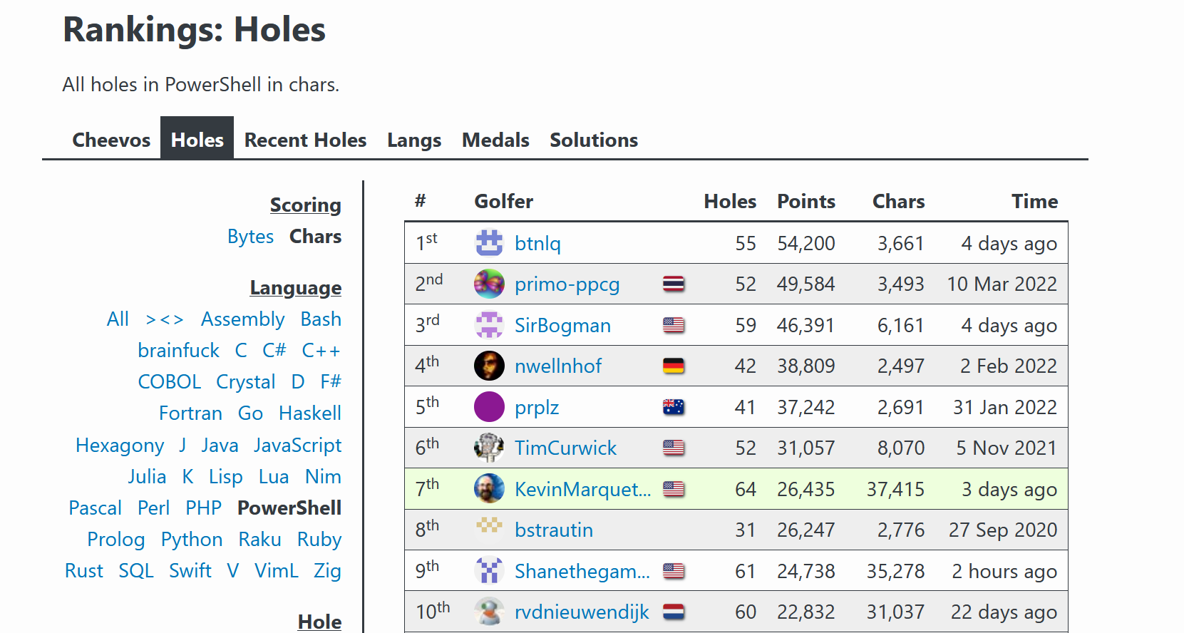
https://code.golf/
37 languages: PowerShell, Python, C#, SQL, bash,…
70+ holes: FizzBuzz, Roman Numerals, Prime Numbers, State Abbreviations,…
Code execution and validation
Leader board

Slide 5
Disclaimer
Just because you can do something, it doesn’t mean you should.
Professional code values readability, uses well named variables, logical, reusable, testable, avoids obscure syntax and clever code
Code golf is none of those things

Slide 6
Show me the code
Basic tips and tricks

Slide 7
EXAMPLE I: FIZZ BUZZ
Print the numbers from 1 to 100 inclusive, each on their own line.
If the number is a multiple of 3 then print Fizz instead
If the number is a multiple of 5 then print Buzz instead
If multiple conditions hold true then all replacements should be printed, for example: 15 should print FizzBuzz.
1 2 Fizz 4 Buzz Fizz 7 8 Fizz Buzz 11 Fizz 13 14 FizzBuzz

Slide 8
Example II: 12 Days of Christmas
Print the lyrics to the song The 12 Days of Christmas:
On the First day of Christmas My true love sent to me A Partridge in a Pear Tree.
On the Second day of Christmas My true love sent to me Two Turtle Doves, and A Partridge in a Pear Tree.
…
On the Twelfth day of Christmas My true love sent to me Twelve Drummers Drumming, Eleven Pipers Piping, Ten Lords-a-Leaping, Nine Ladies Dancing, Eight Maids-a-Milking, Seven Swans-a-Swimming, Six Geese-a-Laying, Five Gold Rings, Four Calling Birds, Three French Hens, Two Turtle Doves, and A Partridge in a Pear Tree.

Slide 9

About Kevin Marquette
PowerShellExplained.com Founder
Microsoft PowerShell MVP 2018-2022
2018 PowerShell Community Hero
SoCal PowerShell User Group Founder
@KevinMarquette
KevMar@gmail.com
github.com/KevinMarquette/CodeGolfPresentation

